Slide 1









Move to Branch-driven ALM for PowerApps
Practical migration path for DevOps and platform teamsCompare environment-driven pipelines with branch-driven mappings, hotfix process, and migration steps for dev, release, main and hotfix branches.
DeepthiPhaniManoj

Slide 2




Current environment-driven ALM: process and pipeline flow
Preserved flow and operational implications for Power Apps project
Replace
Developer Unpack
Local commit and merge to master
Pack
Publish to Development
Continuous Deployment stages
Create a temporary solution in Dev containing changes
Pack pipeline exports the solution and publishes to development environment
Developer runs unpack and commits solution to local branch
Exported solution becomes available in Dev for validation
Developer merges local branch code into master branch
CD pipeline stages artifacts to SIT, UAT, PrePROD, and PROD

Slide 3
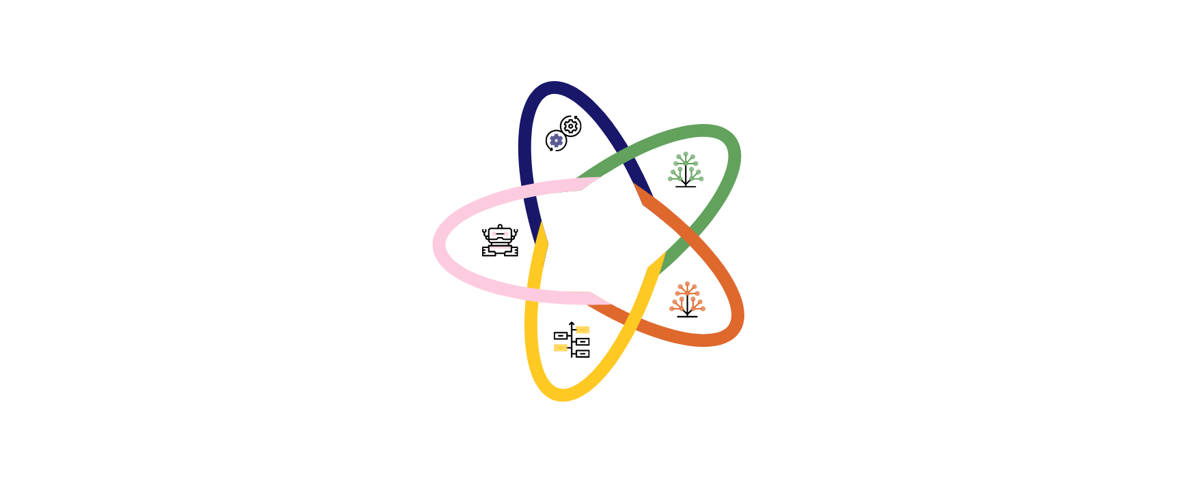
Branch-driven ALM: Branches and Deployment Mapping
Map branches to environments, emergency hotfix flow, and governance controls
Dev branch
Primary development; deploy unmanaged solution to Dev; packaged managed solution promoted to SIT.
Release branch
Integration and stabilization; deploy managed solution to UAT from release branch.
Governance and Automation
Enforce branch policies, protect main, automate packaging, versioning and promotion gates.
Main branch
Production-ready code; deploy managed solution to PreProd and Prod from main.
Hotfix branch
Aligned with main for emergency fixes; deploy unmanaged fix to Dev2 then merge back to dev.

Slide 4
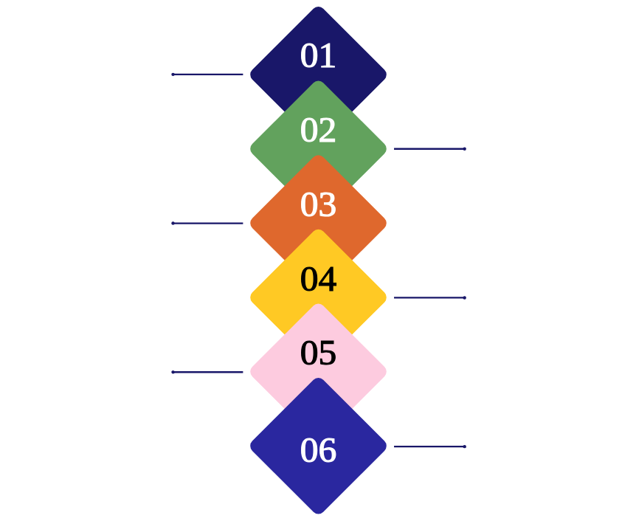
Environment-driven ALM: current pipeline and risks
Dev temporary solutions, unpack/commit, pack, and CD to higher environments
Environments
Nodes for Dev, SIT, UAT, PrePROD, PROD to show flow and boundaries
Pipelines
Replace, Unpack and commit, Pack, then CD deployment stages to higher environments
Developer actions
Temporary solution created in Dev, local unpack and commit, merge to master branch
Artifact handoff
Pack pipeline exports artifacts consumed by CD pipeline for deployments
State changes and coupling
State change points in Dev and manual unpack/commit steps create coupling
Automation targets
Automate unpack/commit, artifact export, and Replace to reduce manual handoffs

Slide 5







Branch-driven ALM: branch to environment pipeline map
Repos, branches, CI actions and promotion gates for Power Apps solutions
01
02
03
04
05
06
Repository and Branches
CI Build and Packaging
Branch to Environment Promotions
Hotfix Flow and Unmanaged Deployments
Gating and Quality Checks
Versioning and Policies
Single repo with branches: dev, release, main, hotfix; show merge paths and protections.
Per-branch CI: build, pack, unpack, automated packaging and solution export validation.
Gates: unit tests, solution export validation, smoke tests, gated promotions and branch protections.
Semantic versioning or solution version increments; enforce branch protections and promotion policies.
Map branches to environments: dev to SIT (managed), release to UAT (managed), main to PreProd and Prod (managed).
Hotfix branch deploys unmanaged to Dev2; after fix merge hotfix to dev for consolidation.

Slide 6
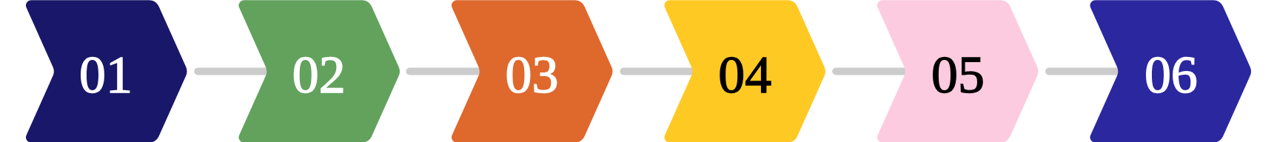
Branch‑Driven ALM Migration and Hotfix Flow
Process steps, merge flows, testing gates, and rollback controls
Define branch policies and protect main
Update CI to build and tag
Configure deployments and environments
Implement Dev2 and hotfix flow
Run parallel validation
Cutover and monitor
Configure pipelines to build packages per branch and tag artifacts
Enable emergency hotfix branch and require merges back to dev
Keep environment-driven pipelines read‑only while validating branch promotions
Switch primary promotions to branch-driven and verify artifact provenance
Establish dev, release, main, hotfix naming and protect main branch
Map dev to SIT (managed), release to UAT, main to PreProd and Prod

Slide 7








Adopt branch-driven ALM with branch protections
Protect master and dev branches; require PRs and CI per branch
Automate CI/CD per branch and solution packaging
Recommendations, Risks, and Next Steps
Per-branch pipelines for pack, unpack, replace and artifact versioning
Formalize hotfix workflow to Dev2 and enforce merge to dev
Hotfix to Dev2, then merge fixes back to dev to avoid drift
Pilot branch-driven ALM with protected branches, automated packaging, and formal hotfix flow
Instrument telemetry and artifact provenance
Track who built what, where and when for traceability
Train developers on new pack/unpack flows and update runbooks
Hands-on training and updated runbooks for new processes

